Slide 1
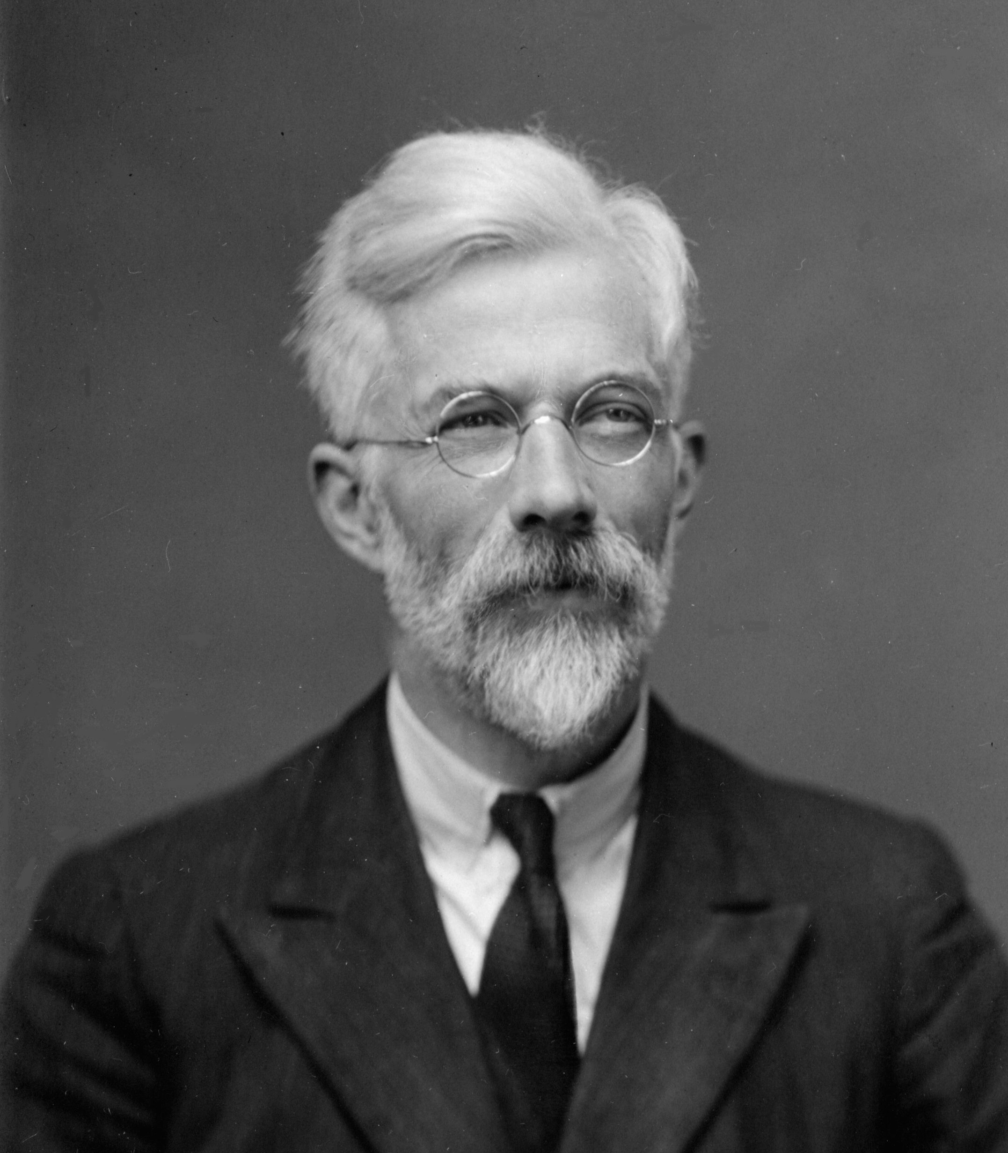

SOEE1475 Statistics and Data Analysis
Lecture 4: Null hypothesis statistical testing
Graeme T. Lloyd

Slide 2

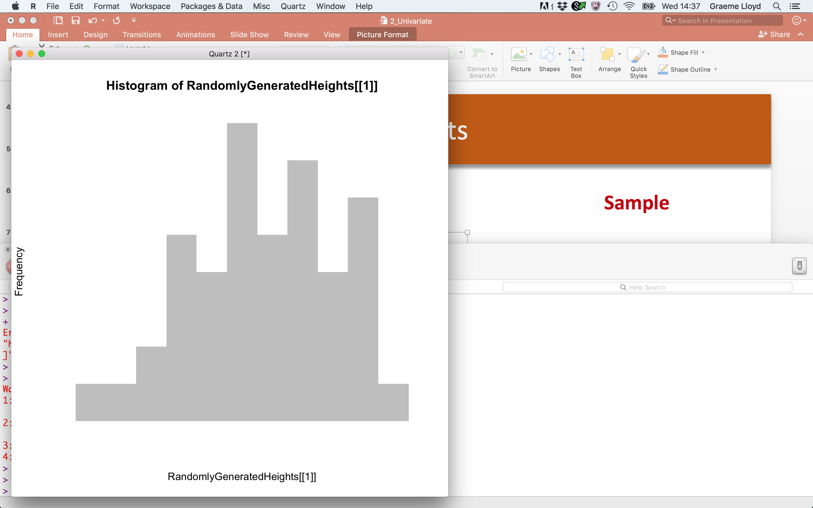
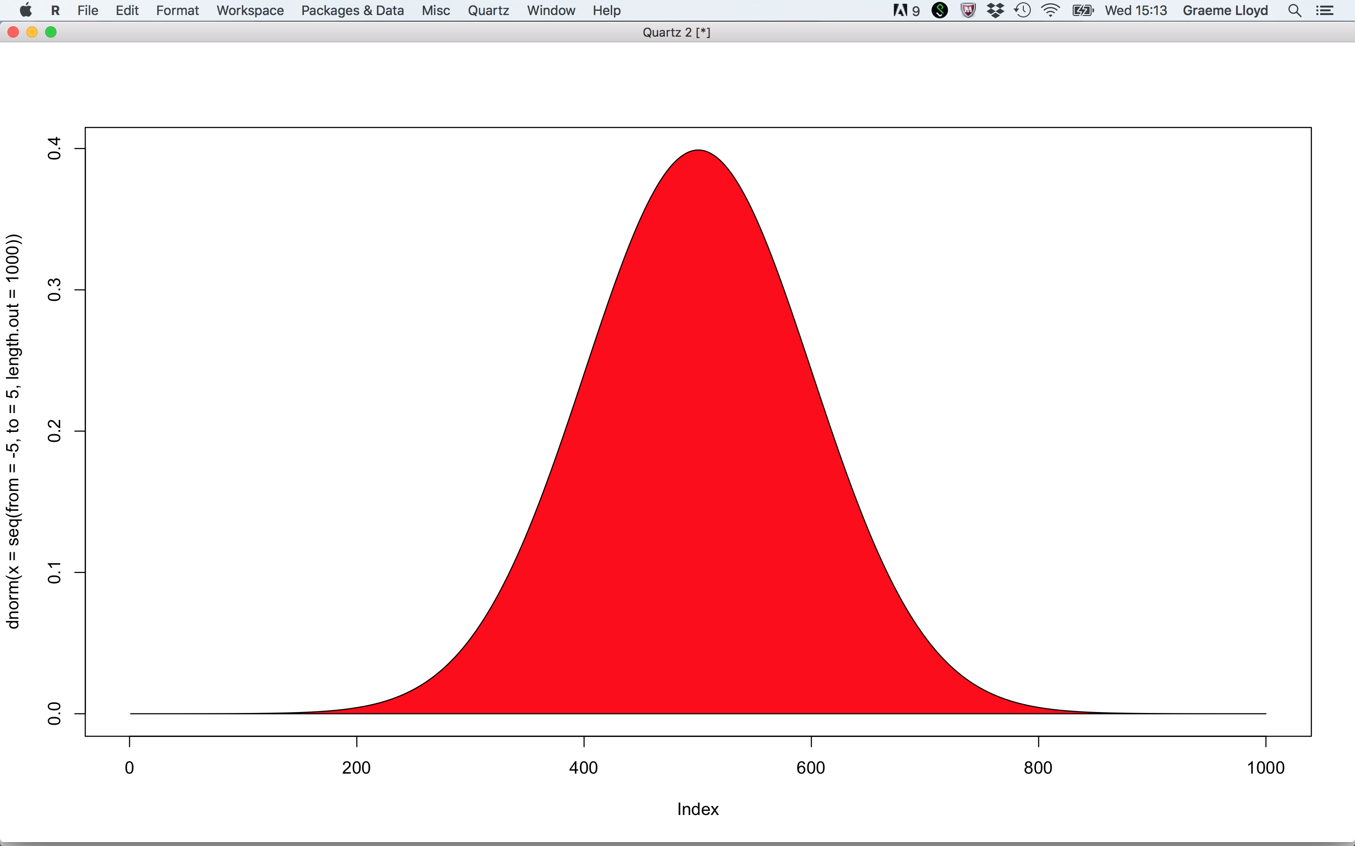
Univariate data
Population
Sample

Slide 3
Bivariate data
y
x

Slide 4
Future
Multivariate data
Temporal, spatial, and directional data

Slide 5
Today
Null hypotheses
Confidence and significance levels
Type I and Type II errors

Slide 6
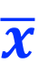
Populations and samples
Population
Sample
Mean
Standard deviation
μ
σ
s
$$\overline{x}$$

Slide 7

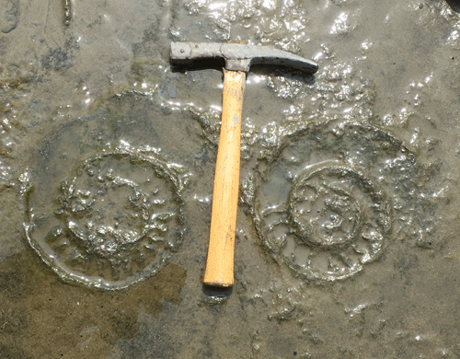
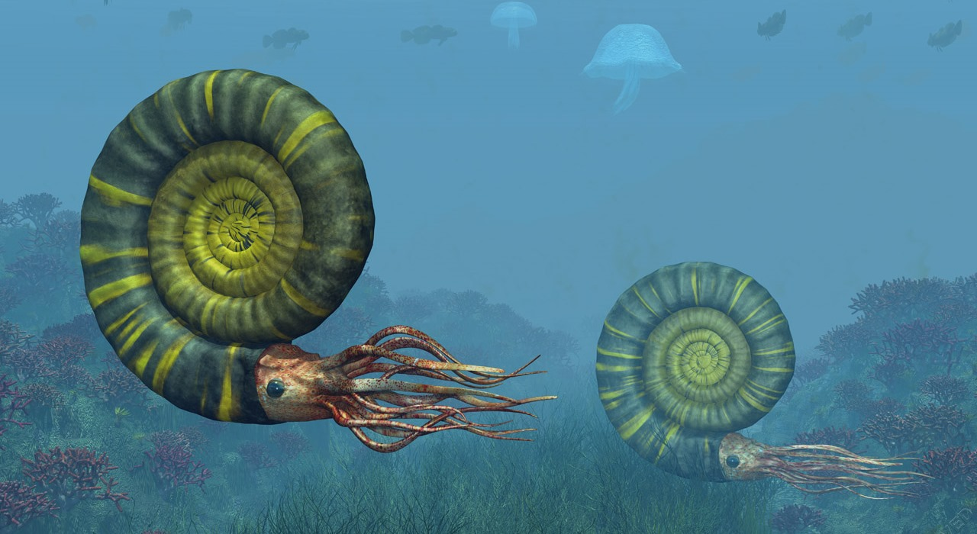
Populations and samples
1
2
3
4
5
6
7
8
9
10
A
B
C
D
E
100 samples
10m
F
G
H
I
J
10m

Slide 8
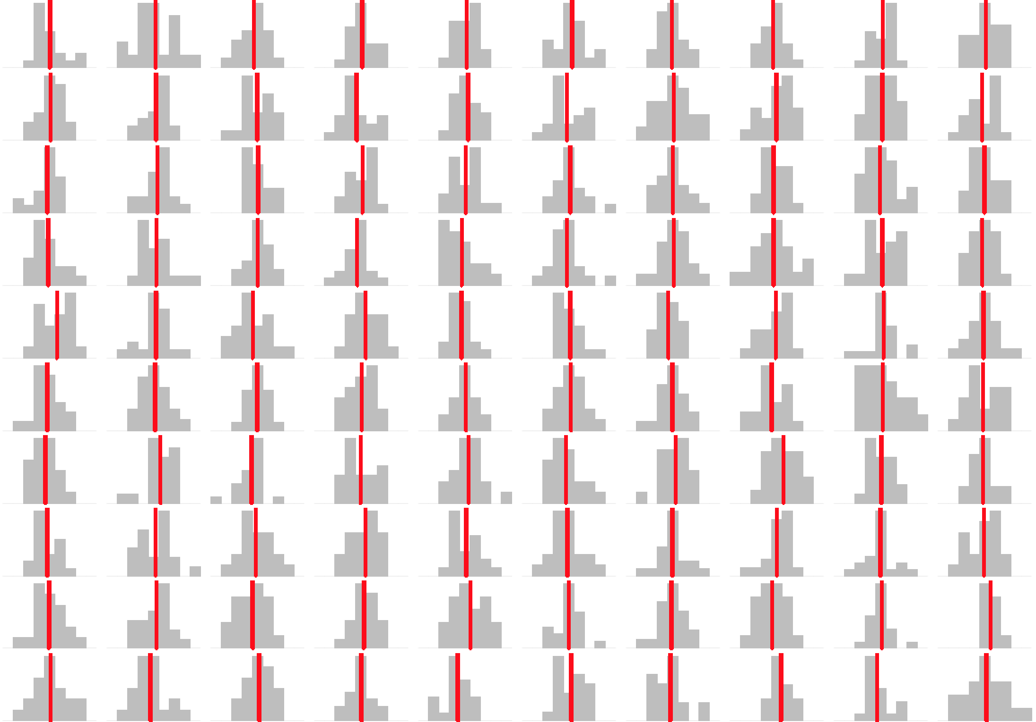
Populations and samples

Slide 9
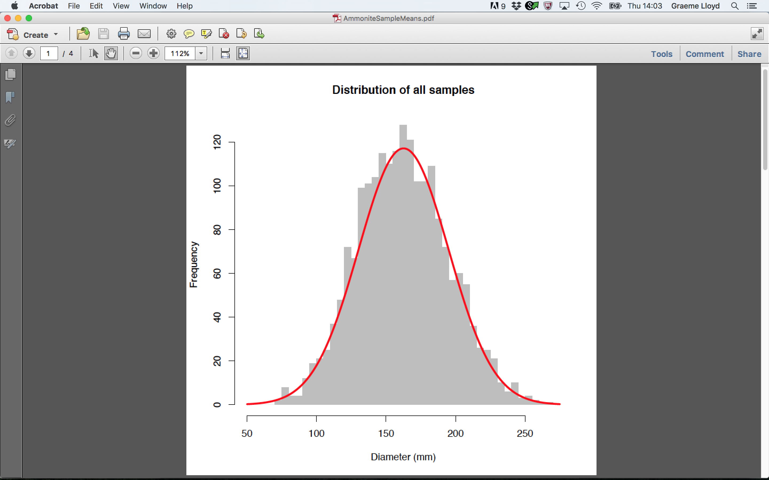
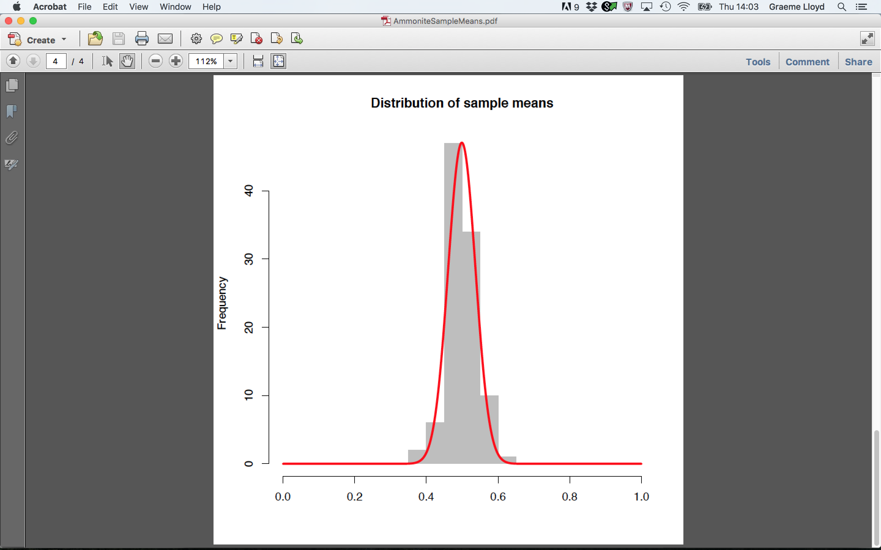
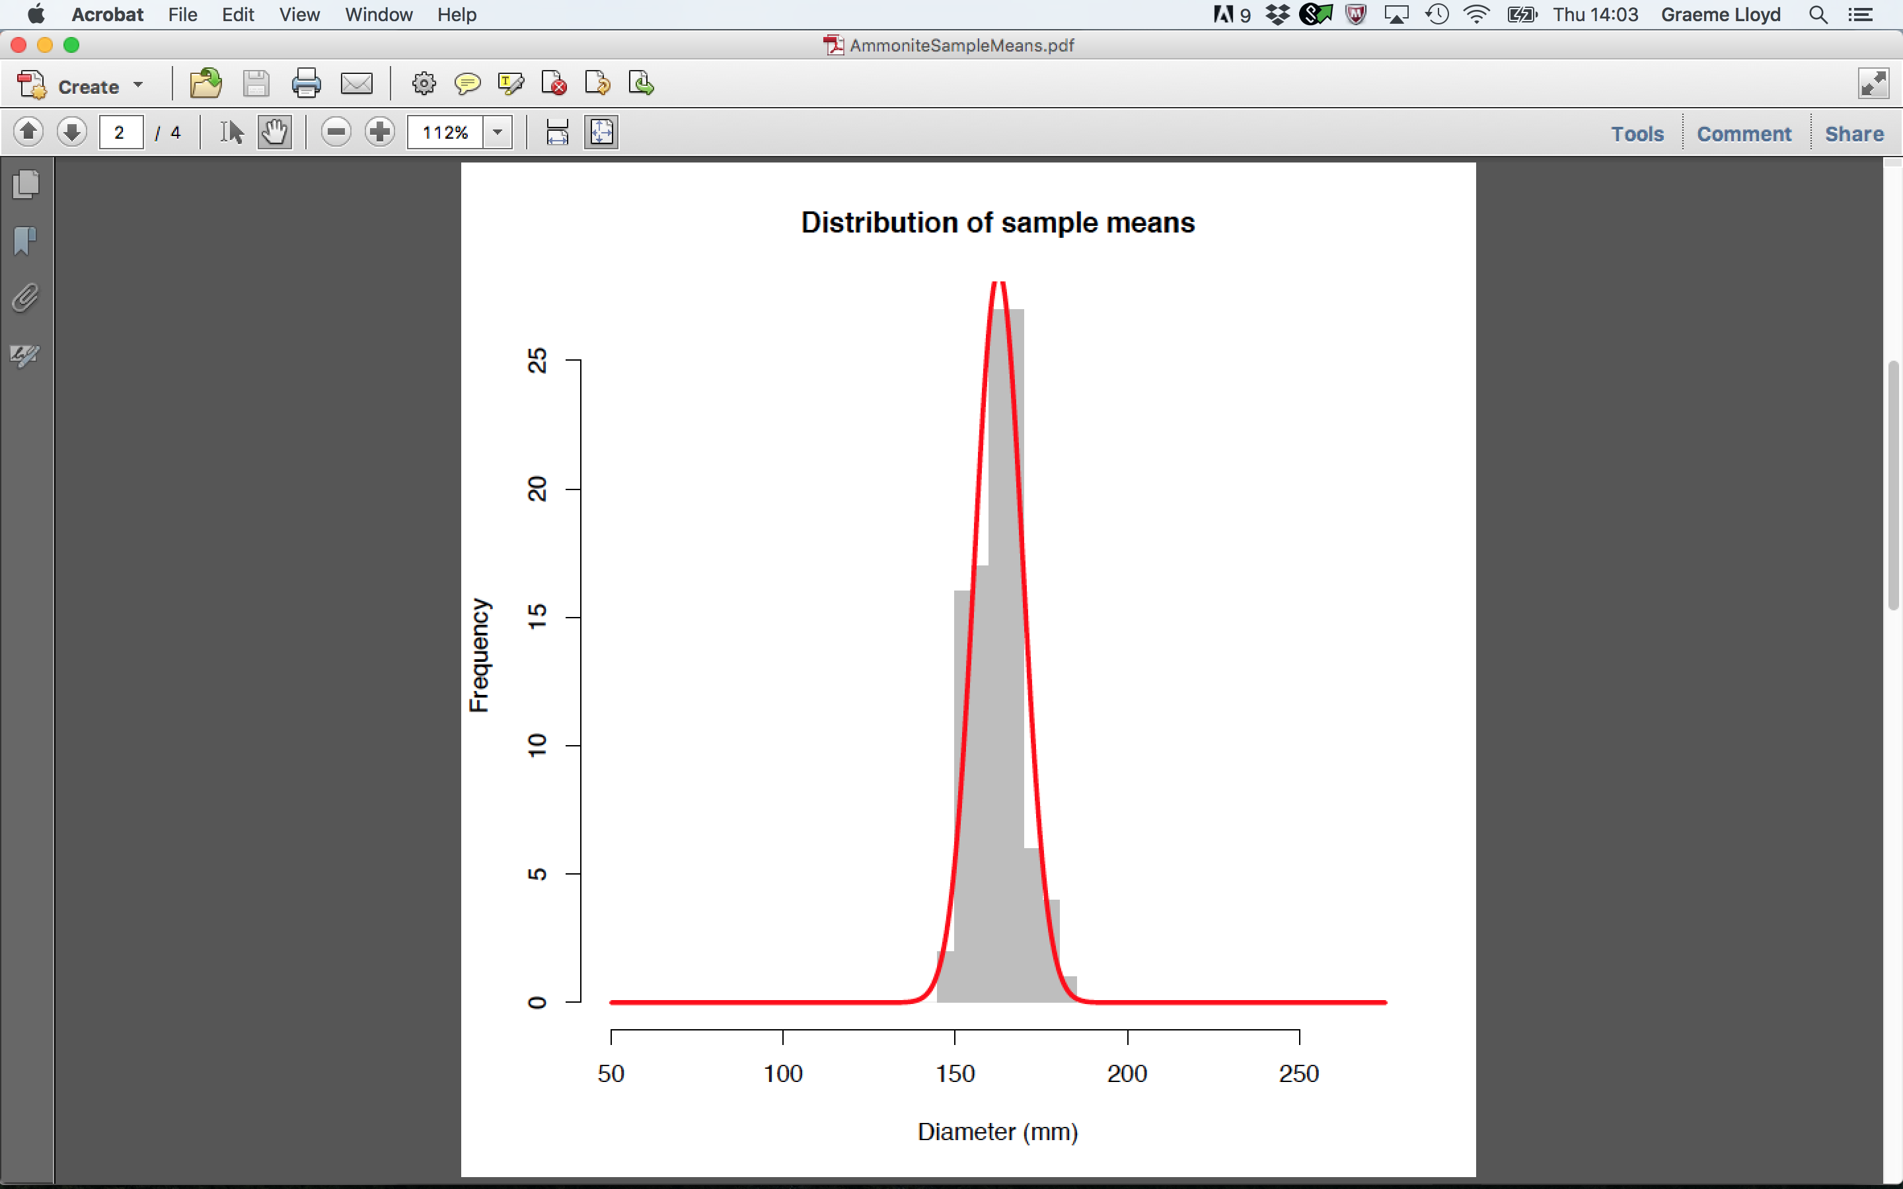
Populations and samples
Pooled sample
Sample means

Slide 10
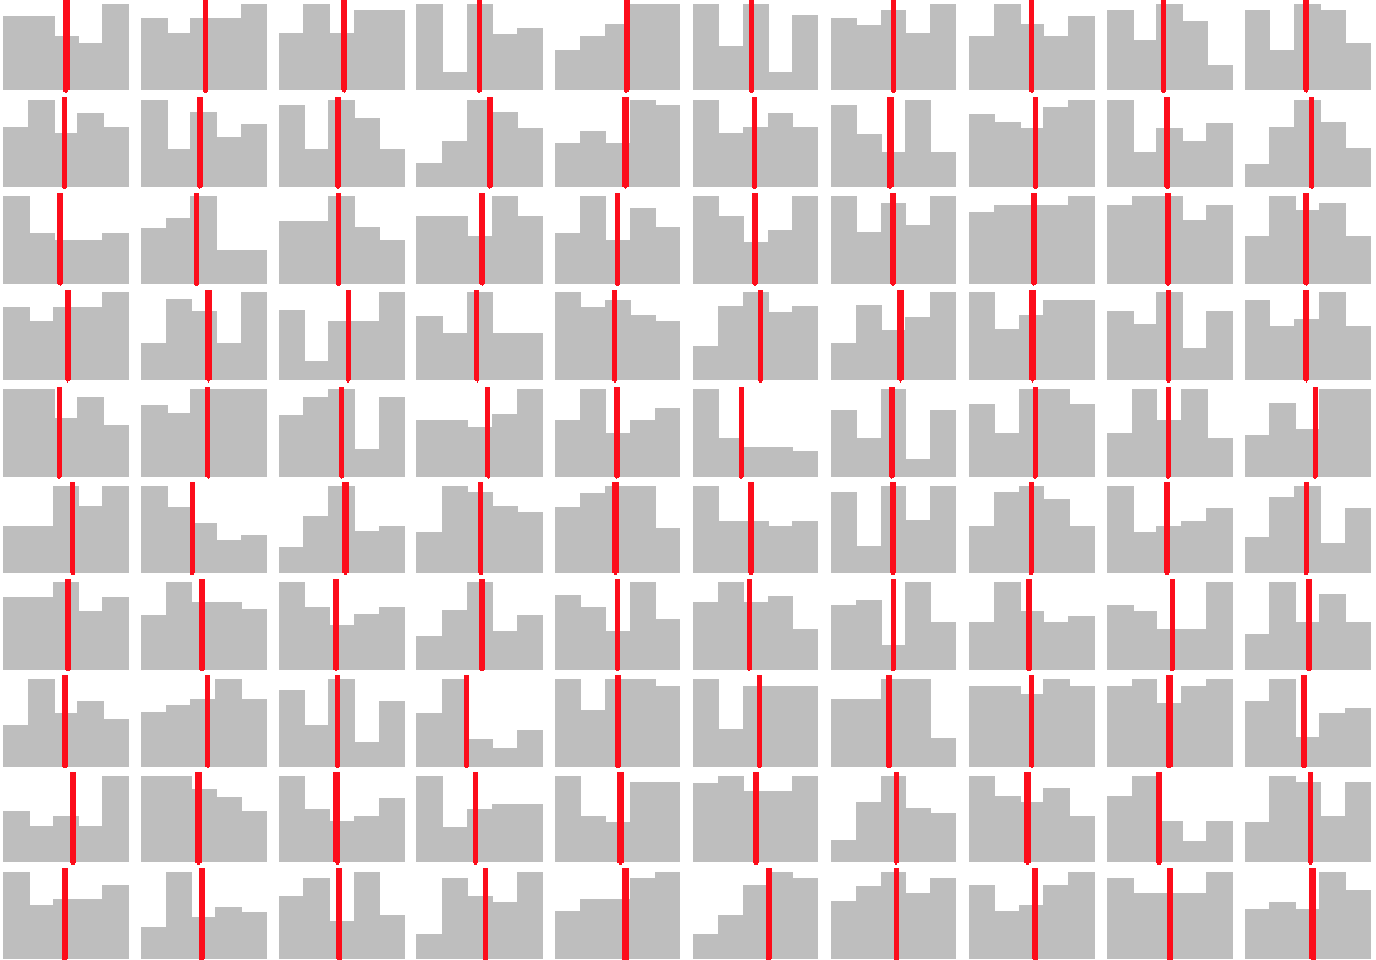
Populations and samples

Slide 11
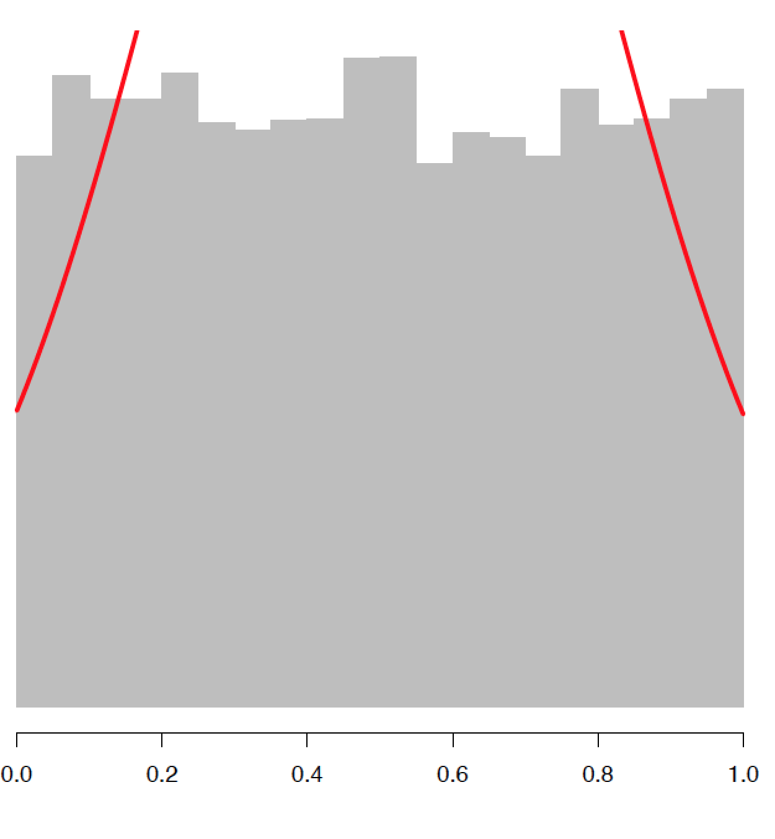
Populations and samples
Pooled sample
Sample means

Slide 12
Populations and samples – implications
Sample means are normally distributed
Holds regardless of the distribution of samples; Central Limit Theorem
Mean of sample means ≈ population mean
If we have ∞ samples, mean of sample means = population mean
Distribution of sample means has its’ own standard deviation
A dispersion metric, standard error of the mean (SEM)

Slide 13

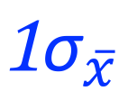
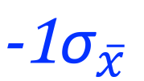
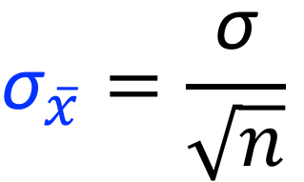
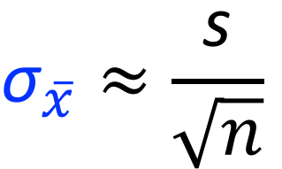
Standard error of the mean, ${\text{σ}}_{\overline{x}}$
$${\text{σ}}_{\overline{x}}=\frac{\text{σ}}{\sqrt{n}}$$
Middle
68.2%
$${\text{σ}}_{\overline{x}}≈\frac{\text{s}}{\sqrt{n}}$$
$${\text{−1}\text{σ}}_{\overline{x}}$$
$${\text{1}\text{σ}}_{\overline{x}}$$

Slide 14
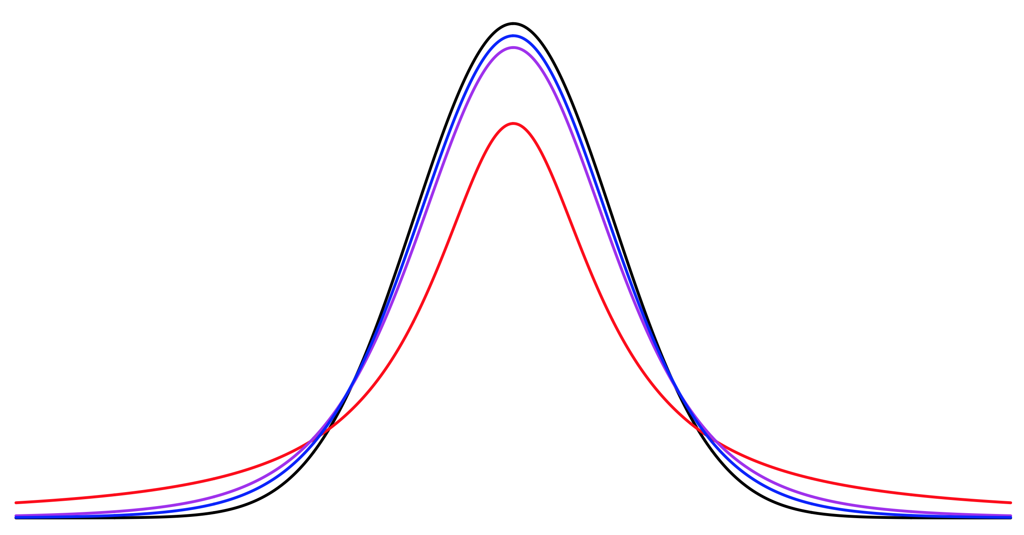
Standard error of the mean, ${\text{σ}}_{\overline{x}}$
t-distribution (n = 2)
Normal distribution
t-distribution (n = 6)
t-distribution (n = 11)

Slide 15
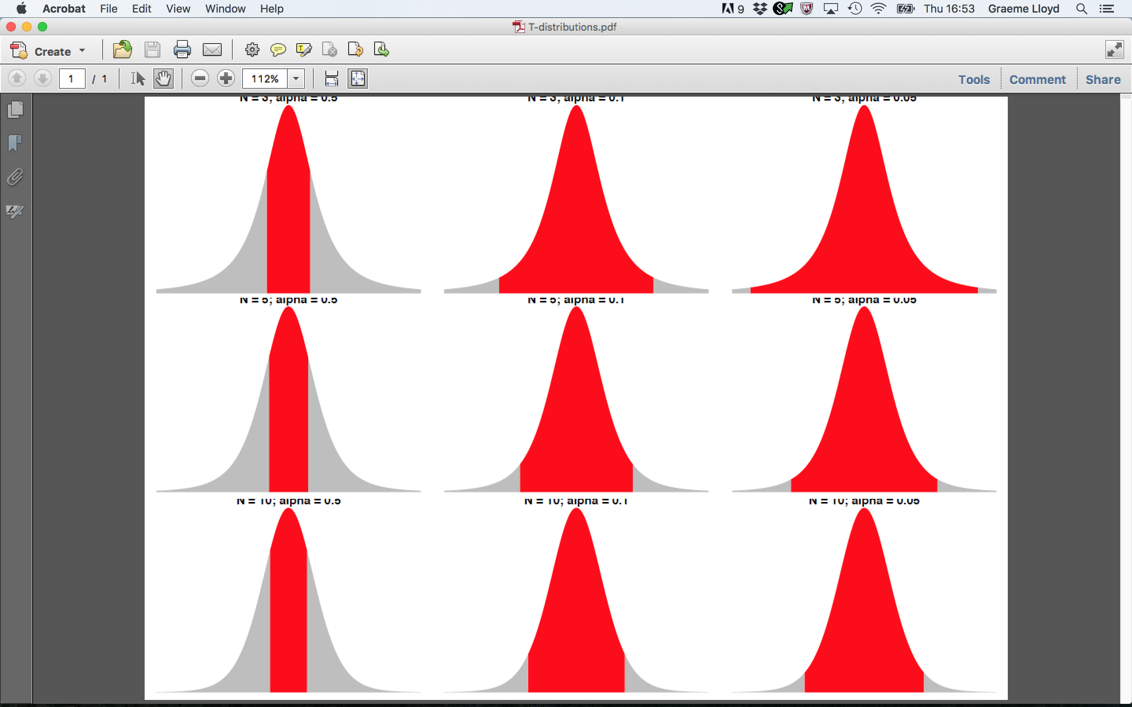

Confidence intervals and ${\text{σ}}_{\overline{x}}$
Conf. = 50%
Conf. = 90%
Conf. = 95%
N = 3
N = 5
N = 10

Slide 16
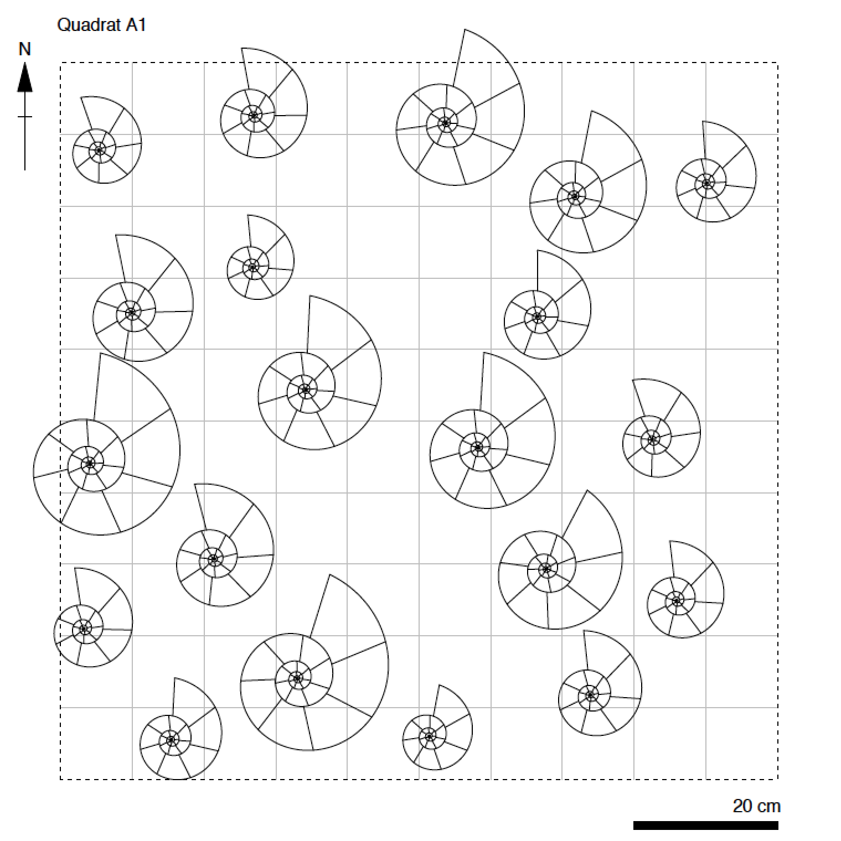
Exercise

Slide 17

Exercise
p(at least two people in the room share a birthday)

Slide 18
Exercise
Option A
0.0-0.2
Option B
0.2-0.4
p(2+ shared birthdays) =
Option C
0.4-0.6
Option D
0.6-0.8
Option E
0.8-1.0
Notes:
Ask class to pick a range they think the answer falls in (count N people in lecture first)

Slide 19
A blueprint for science
Pick interesting question
Framed in form of a hypothesis
Collect data
Measure at appropriate precision; avoid biased samples
Perform statistics
Choose appropriate test; accept or reject hypothesis
Notes:
To avoid “making up” the answet we should apply an appropriate test with clear a priori interpretations of results

Slide 20
Null and alternative hypotheses
Null hypothesis – H_{null} / H₀
Simplest, boring, often stochastic explanation
Alternative hypothesis – H_{alt} / H₁
Not the null, interesting, may incorporate multiple outcomes

Slide 21
Null and alternative hypotheses
H_{null} / H₀
H_{alt} / H₁
μ_{hyp.} > CI_{upp} or
μ_{hyp.} < CI_{low}
One-sample t-test
CI_{low} < μ_{hyp.} < CI_{upp}
Two-sample t-test
μ_{A} = μ_{B}
μ_{A} < μ_{B} or μ_{A} > μ_{B}
ANOVA
μ_{A} = μ_{B} = μ_{C}…
μ_{A} > μ_{B} = μ_{C} or...
Correlation
r = 0
r > 0 or r < 0

Slide 22
Choosing a hypothesis
Significance-level
Decides threshold value between accepting or rejecting null; termed alpha
Confidence-level
One minus alpha; often expressed as a percentage

Slide 23
Choosing a hypothesis
One-tailed
Only care whether value falls to left or right of alpha
Two-tailed
Allow alpha to be split equally in two; accounts for higher and lower values

Slide 24
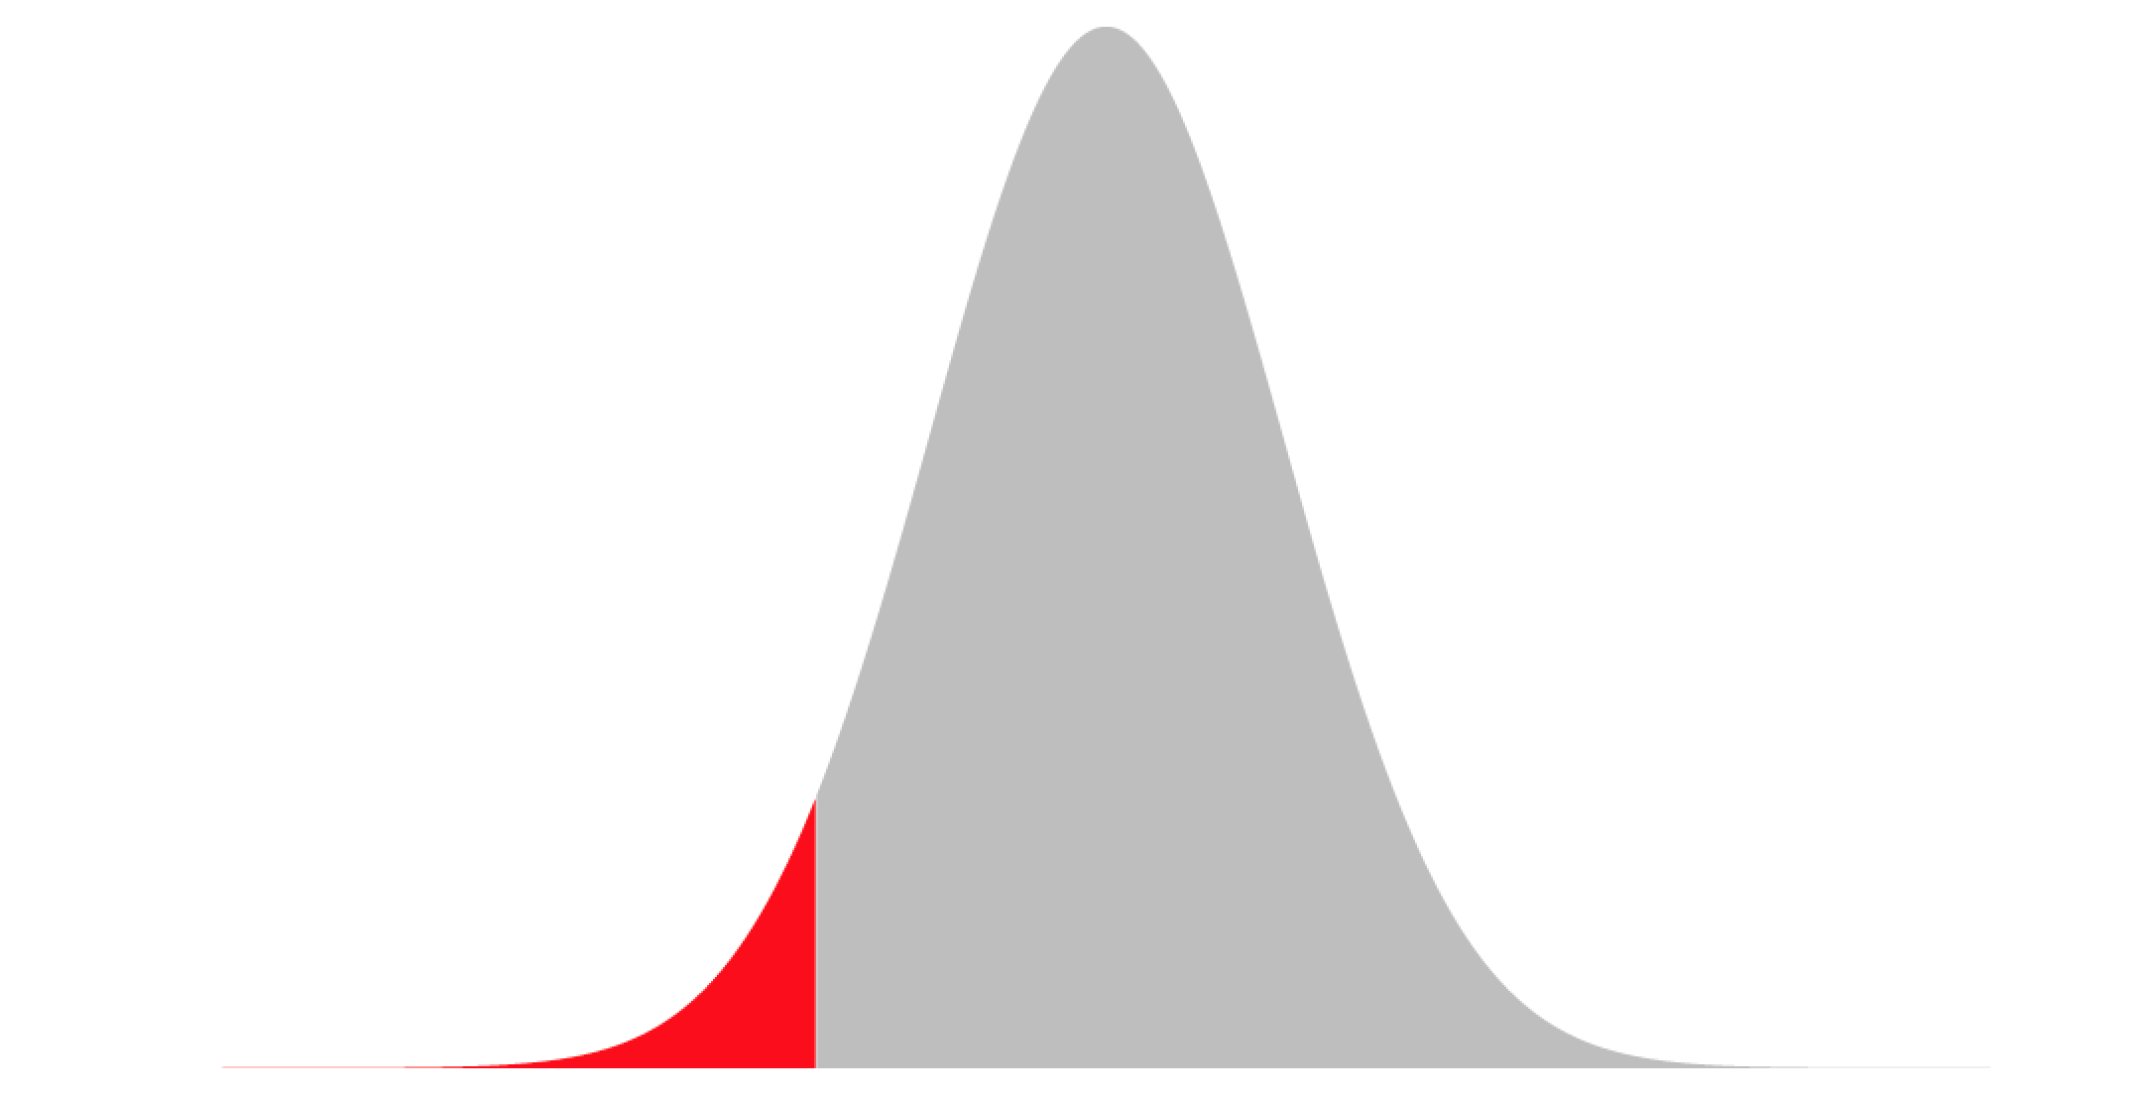
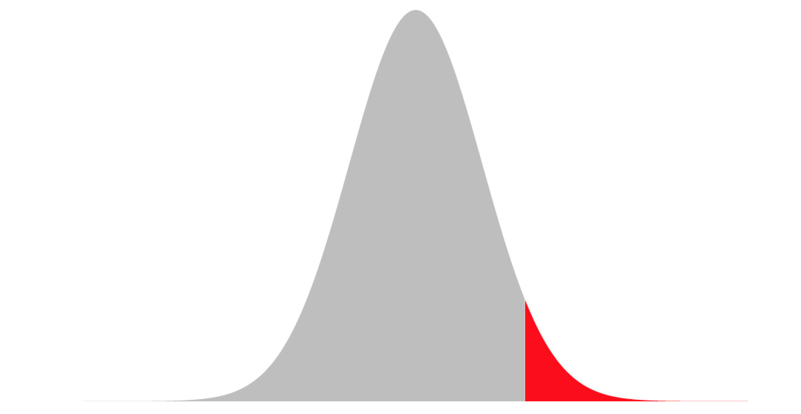
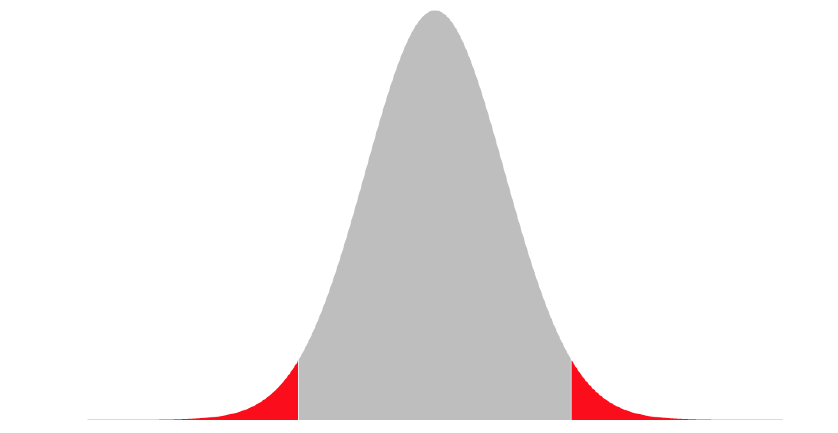
Choosing a hypothesis
Left-tailed
Right-tailed
Two-tailed
α
α
α/2
α/2
H₁
H₀
H₀
H₁
H₁
H₀
H₁

Slide 25
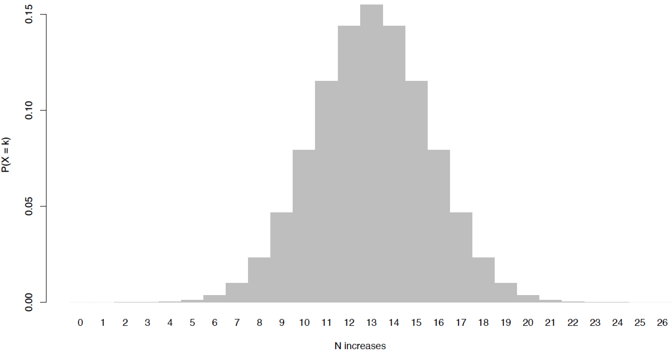
Choosing a hypothesis
α = 0.5
(Two-tailed test)
CI = 0.5
Accept H₀
H₁
H₀
H₁
>
≈
>

Slide 26
Choosing a hypothesis
Type I error
Rejecting the null when the null is correct (false positive)
Type II error
Accepting the null when the null is incorrect (false negative)

Slide 27
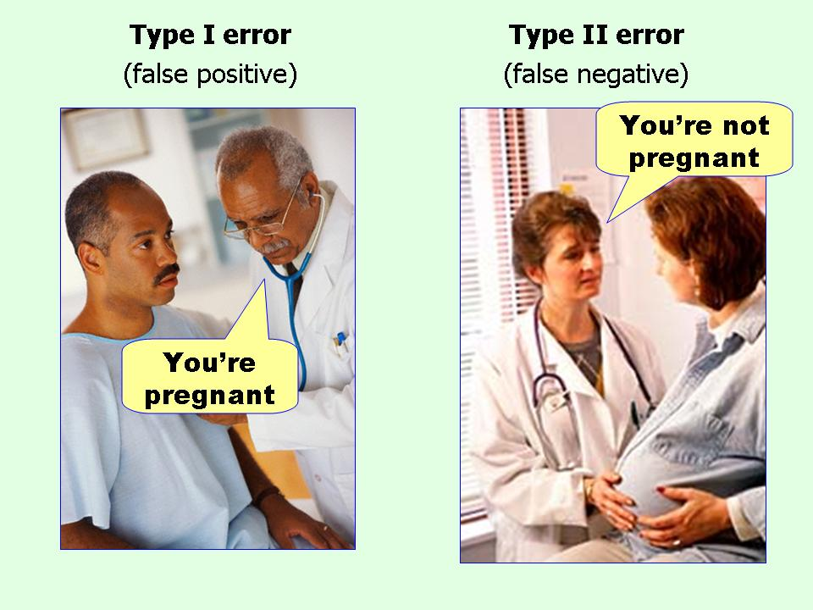
Type I and Type II errors
Type I error
Type II error
False positive
False negative

Slide 28
Problems with null hypothesis tests
Choosing alpha
No clear ideal value
Counterintuitive
Typically about low probability of model we believe is incorrect
Sample size dependency
Low sample sizes frequently lead to Type II errors

Slide 29
Alternatives to null hypotheses
Maximum likelihood
Most likely value or model regardless of absolute probability
Bayesian statistics
Expresses probabilities as degrees of belief that update with new data

Slide 30
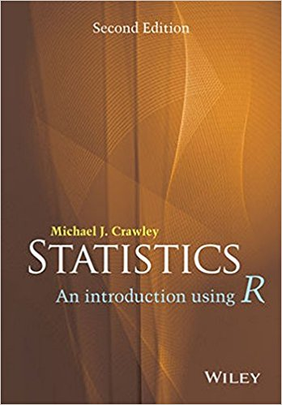




Reading
Statistics An Introduction
Using R
Crawley
The Numbers Game
Anderson
and Sally
The Theory That Would Not Die
McGrayne
Bad Science
Goldacre
Flatland
Abbott

Slide 31
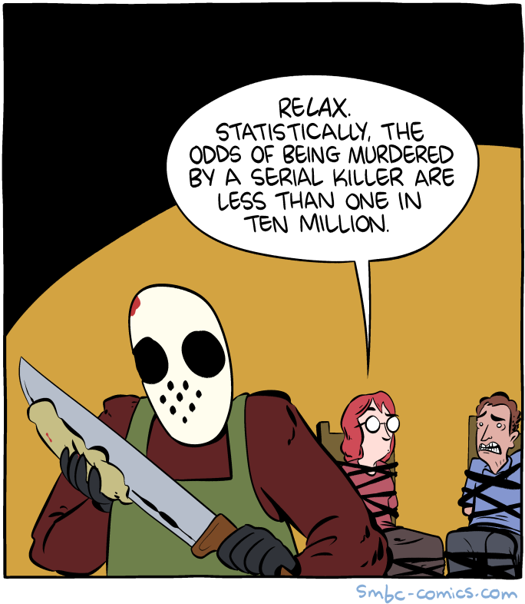
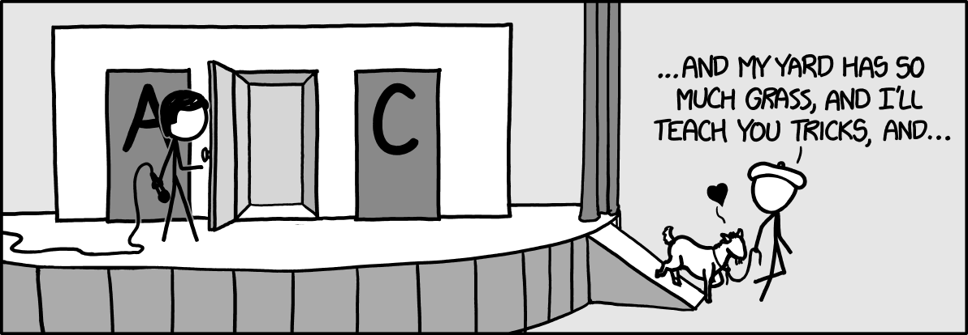
Web comics
Saturday Morning
Breakfast Cereal
xkcd

